Slide 1
Excel Charts
© McGraw Hill LLC. All rights reserved. No reproduction or distribution without the prior written consent of McGraw Hill LLC.

Slide 2


What’s Your Data Type?
Your data type dictates the appropriate chart type.
Cross sectional data (x₁, x₂, … , x_{n})
Numerical data: histogram, bar chart, boxplot
Categorical data: bar, column, pie, area
Time series data (y₁, y₂, … , y_{n}): line chart, bar chart
Bivariate data (x₁,y₁), (x₂,y₂), … , (x_{n},y_{n}): scatter plot
Tip: Statistics packages (e.g., JMP, Minitab) offer more choices for statistical data analysis. MegaStat (or similar Excel add-ins) improve on Excel’s charts.

Slide 3

Insert Chart
Highlight your data and click the insert ribbon to see chart options.
Column
Treemap
Stock
Line
Combo
Pie
Statistics
Scatter
Tip: These are the chart types you are most likely to use in a statistics class. Chart icons are somewhat intuitive.

Slide 4


Insert Chart
The Recommended Charts icon offers an informed guess of the best chart to use.
Tip: Excel’s recommendation may not be the best choice for a statistics class.

Slide 5
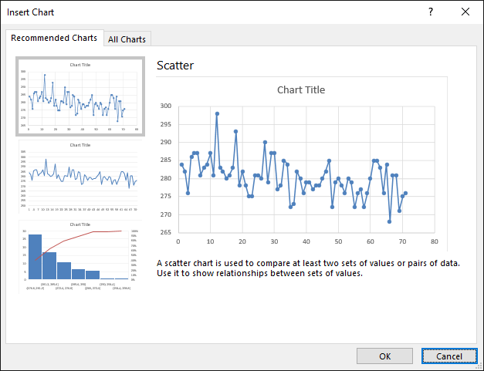
Insert Chart
Click on Recommended Charts to see what Excel offers.
Tip: Excel shows a peview of the proposed chart. However, don't blindly rely on Excel's suggestions.

Slide 6
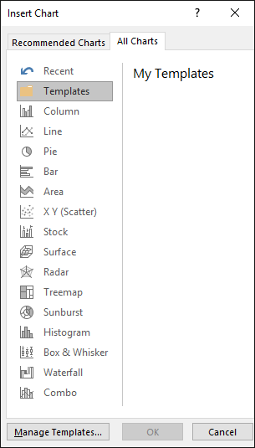
Insert Chart
Click on All Charts to see the chart types.
Or skip the Recommended Charts and try any chart you like.

Slide 7
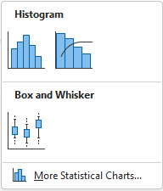

Statistics Charts
Excel offers two useful charts for a statistics class.
Column chart showing frequency of data values within each data range (classes are called “bins”).
Plot of X_{min}, X_{max}, quartiles Q₁, Q₂, Q₃ (25%, 50%, 75%), and “fences” to demark outliers.
Statistics
Tip: To see these chart options, click on the center icon called Statistic.

Slide 8
Statistics Charts
Example: Excel’s histogram and boxplot of 76 winning scores in the men’s U.S. Open golf tournament from 1946 to 2022
Class limits
Outlier

Slide 9
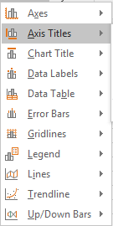
Chart Edit Tools
Tip: Customize your chart after you have created it. One way is to click on the chart and view the Design ribbon.
Tip: For example, use Add Chart Element to add descriptive titles to your graph and its axes.

Slide 10
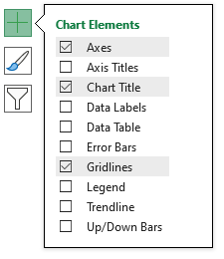
Chart Elements
Tip: Instead of using the Design ribbon, just click on the chart and the  symbol to the right to customize your graph using Chart Elements.

Slide 11
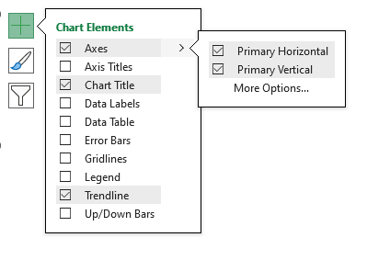
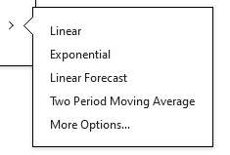
Chart Elements
Tip: You can improve the titles or add a fitted trend after creating the basic chart.

Slide 12
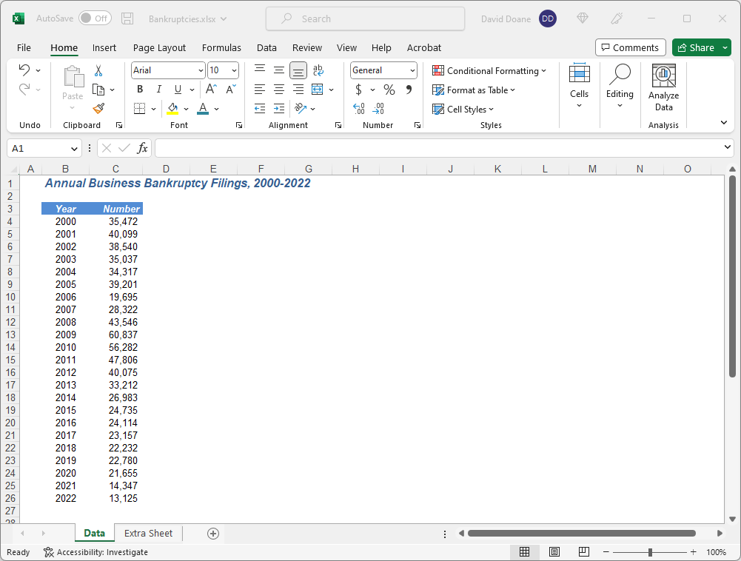
Data Entry
Step 1. Enter the data.

Slide 13
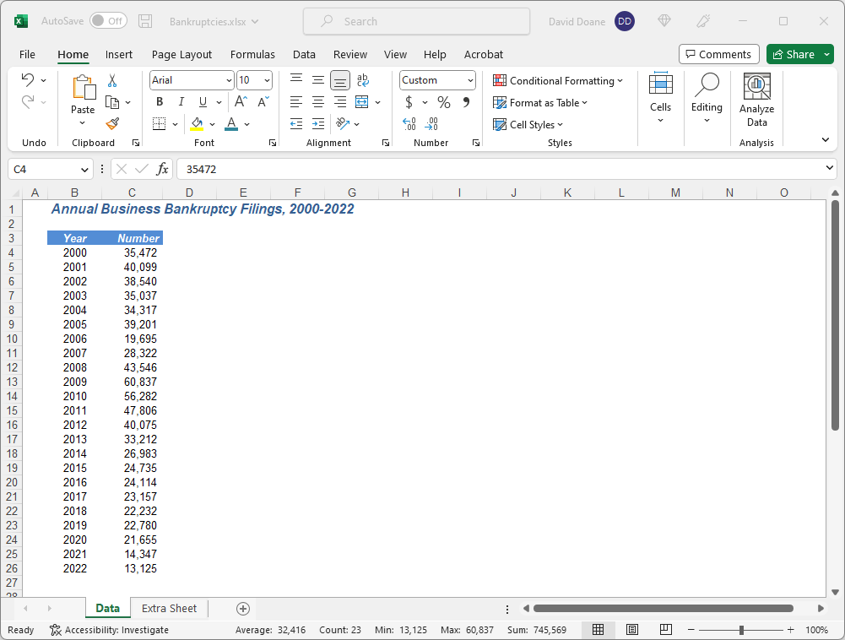
Select Data
Step 2. Highlight the data (not the heading).
Tip: You can add the axis labels later.

Slide 14
Select Chart
Step 3. Click Insert ribbon and choose chart type and style.
Tip: For a time series we choose a line chart.

Slide 15
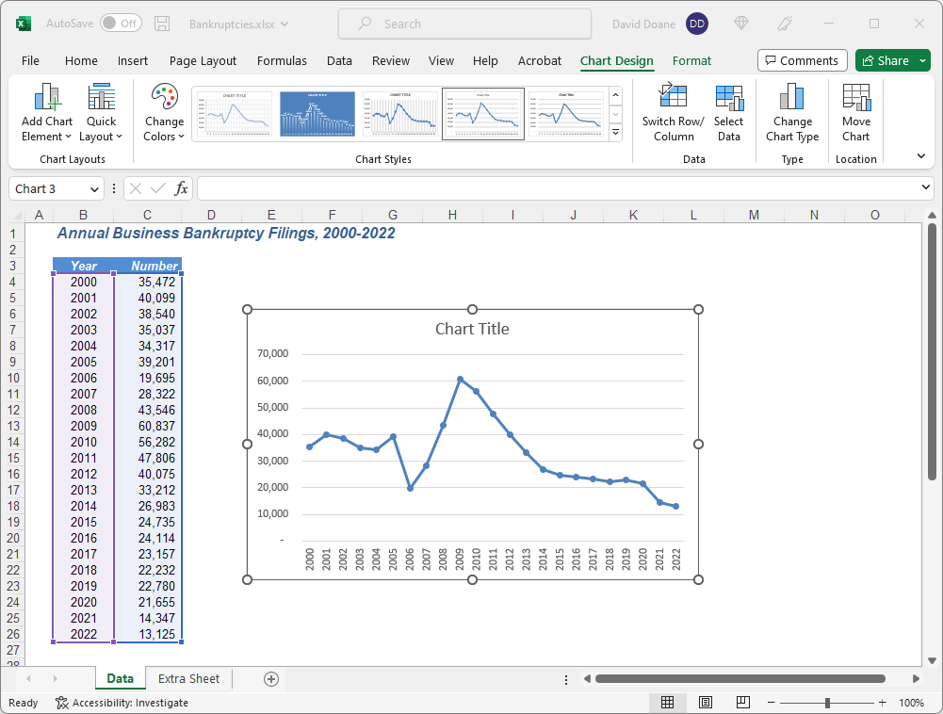
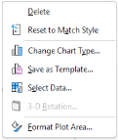
Axis Labels?
Step 4. Right-click on graph and choose Select Data.
Tip: Add the years as x-axis labels after creating the chart. They are treated as labels not numbers.

Slide 16
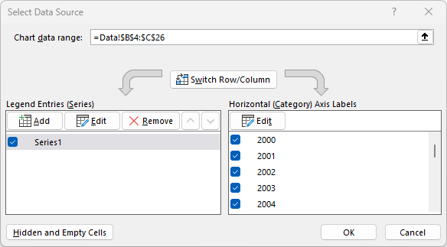
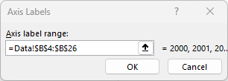
Select Axis Labels
Step 5. Enter x-axis label range after you click Edit.
This range contains the years 2000-2012.

Slide 17
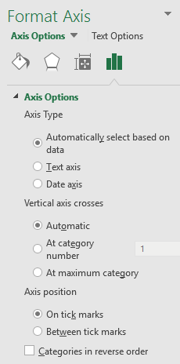
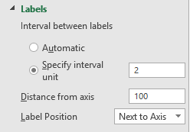
Align Data with Axis Ticks
Step 6. Right-click on x-axis and position labels.
Tip: Excel centers each data value in the middle of the axis interval. That’s OK for a bar chart, but for a line chart we want to align data with axis ticks. Also, click Text Options
We can label every other year to avoid crowding the labels.

Slide 18
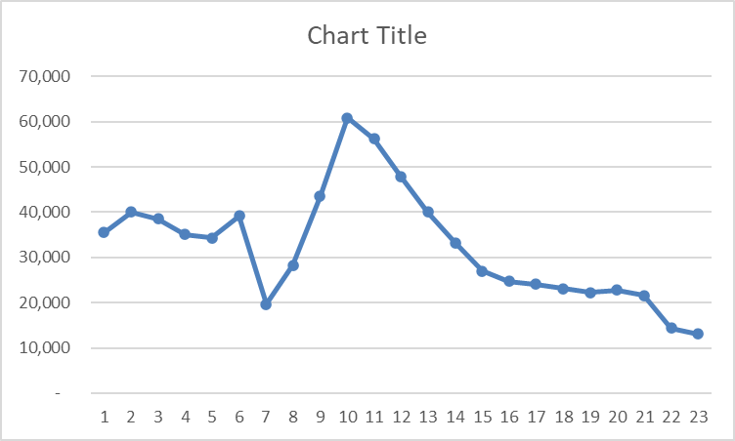
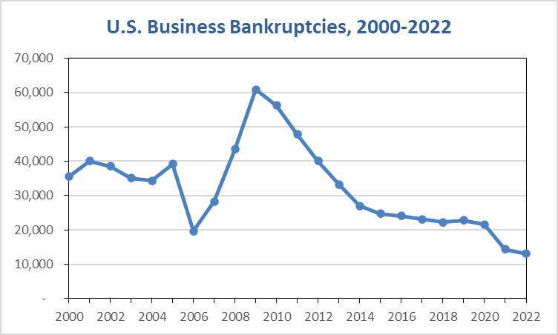
Customize Chart
Step 7. Edit colors, borders, and titles.
Tip: Right-click a graph feature that you want to edit and follow the menus that appear.
Default Chart
With Labels

Slide 19
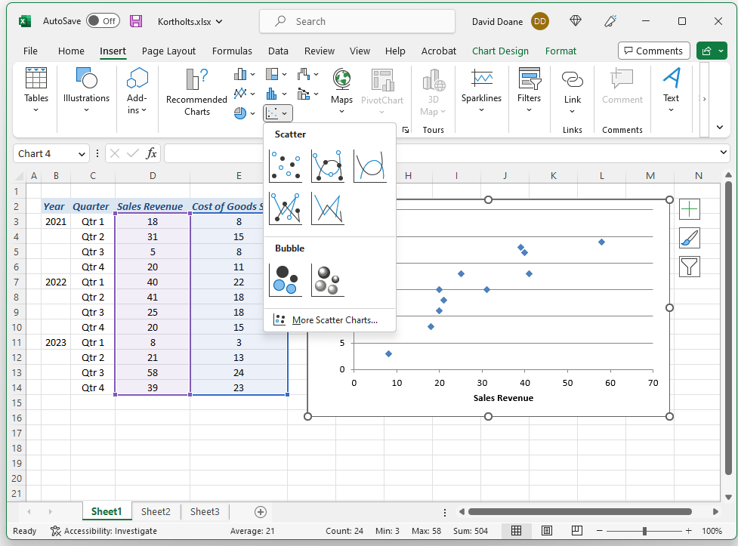
Scatter Plot
Tip: Highlight only the X and Y data (not the column headings) and click Insert.
Tip: You can add nice axis labels later by clicking the  in the upper right of the chart.

Slide 20
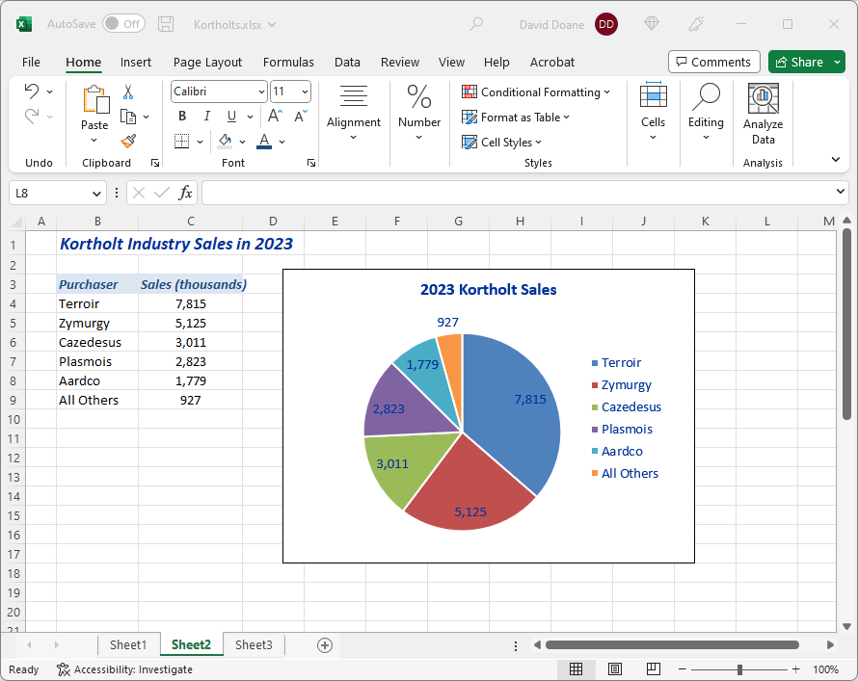
Pie Chart
Tip: Use a pie chart only to display parts of a whole (must sum to 100%).
Tip: A pie chart becomes awkward if there are many categories.

Slide 21
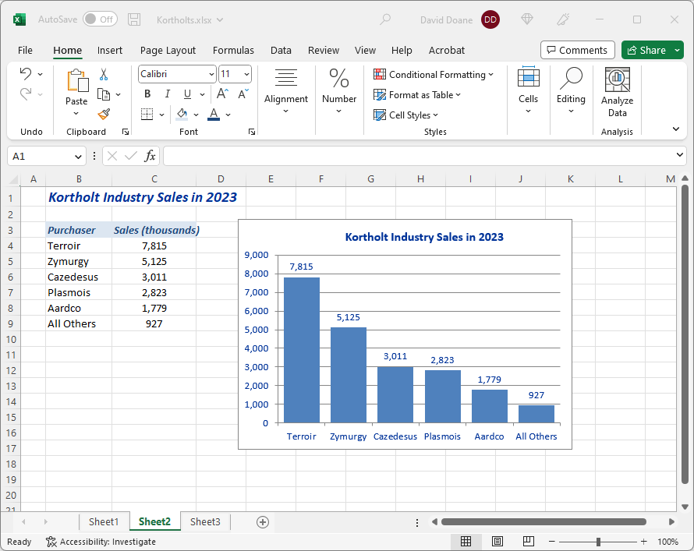
Column Chart
Tip: A column chart may be clearer than a pie chart to compare data magnitudes.

Slide 22
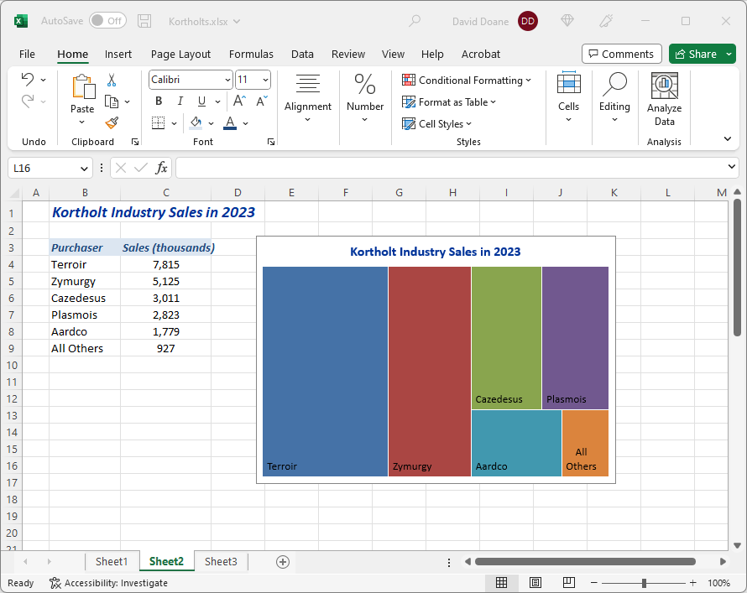
Column Chart
Tip: A treemap can be used to display data that comprise parts of a whole (must sum to 100%).

Slide 23
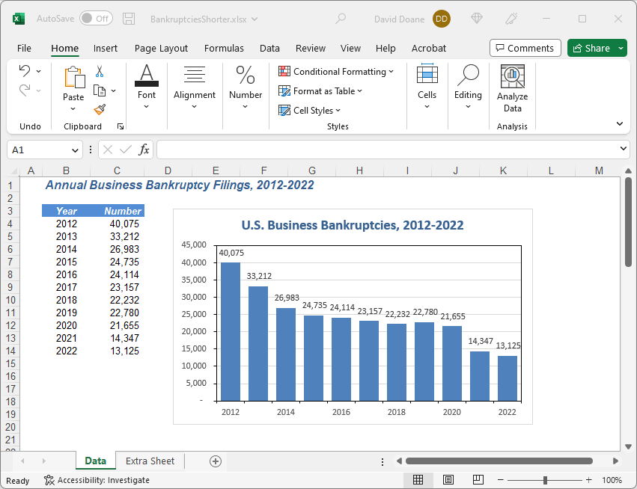
Time Series Column Chart
Tip: It’s OK to use a column chart to plot a time series. Always put time on the x-axis. Add data labels if you’re showing only a few time periods.

Slide 24
Bottom Line
Charts are important in business.
Excel charts are versatile.
Excel defaults are rather plain.
Why not take control? Customize!

